Slide 1
Internship Week 6
Samarth Sharma

Slide 2
ESPRIT SPFL on the board

Slide 3
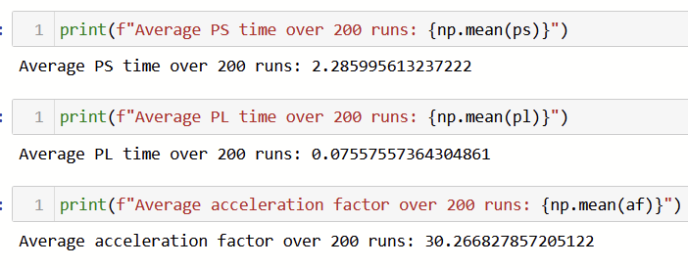

Slide 4
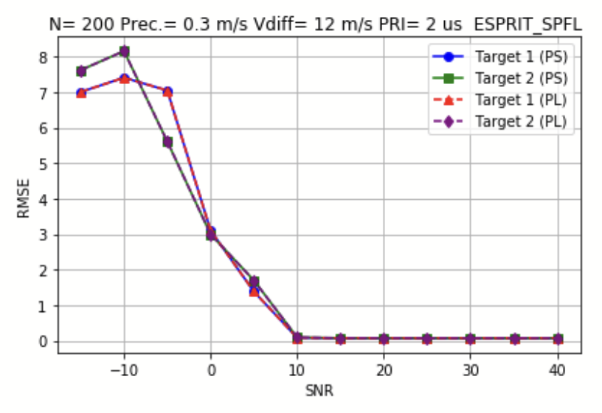
RMSE

Slide 5
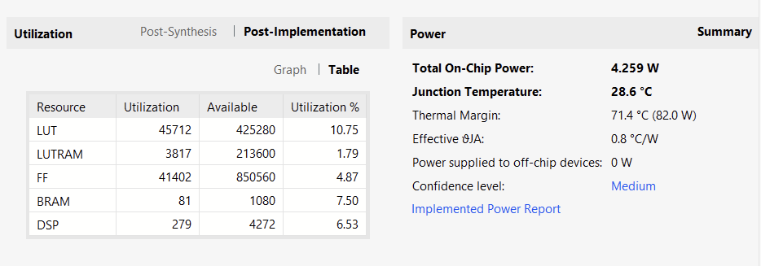
Vivado Resources

Slide 6
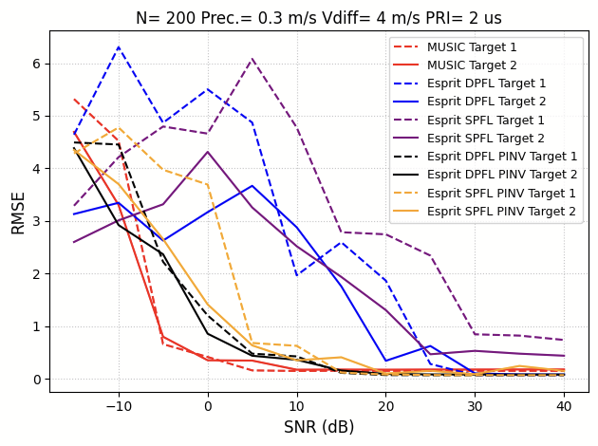

Slide 7
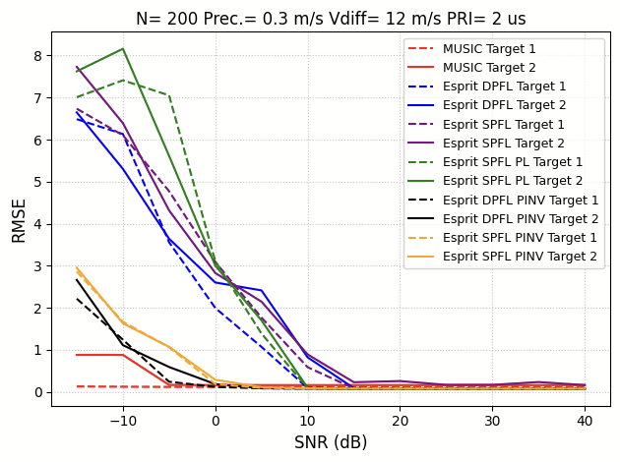

Slide 8
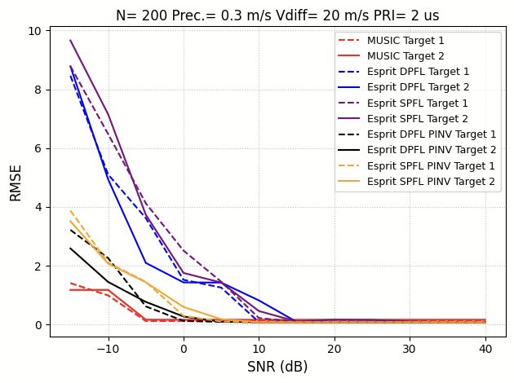

Slide 9
QR vs SVD

Slide 10
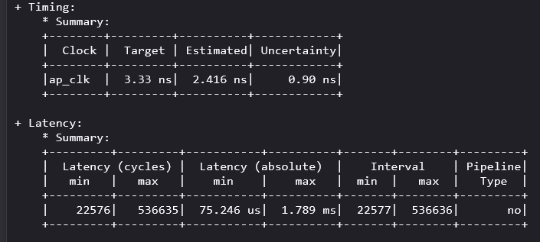
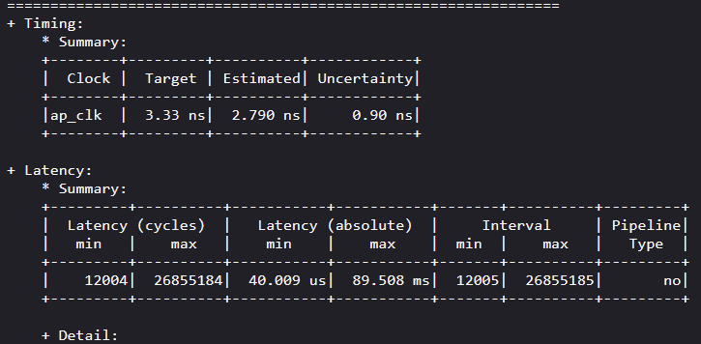
QR
SVD
Arch0
All results are for 50x50

Slide 11
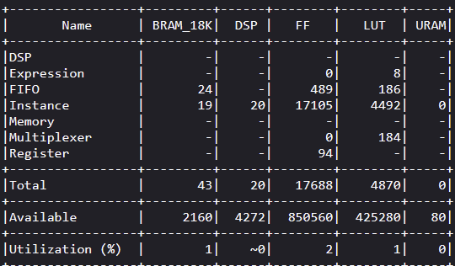
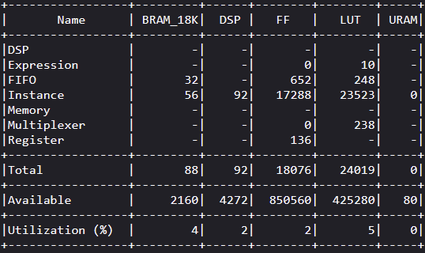
QR
SVD
Arch0

Slide 12
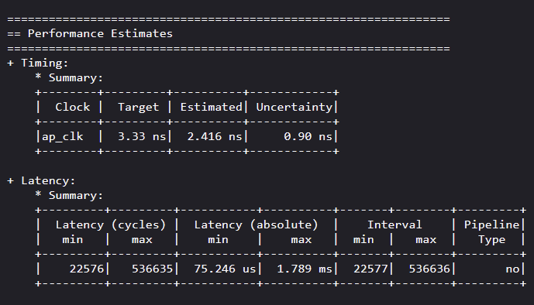
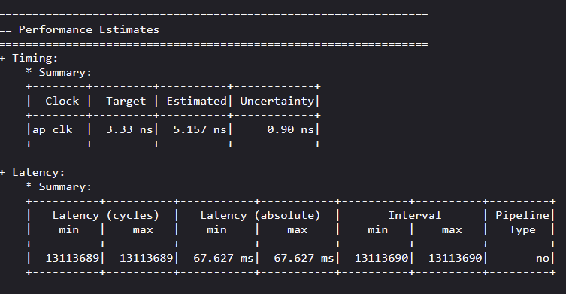
QR
SVD
Arch1

Slide 13
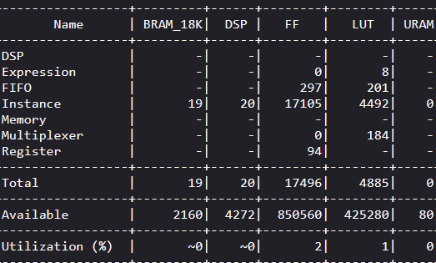
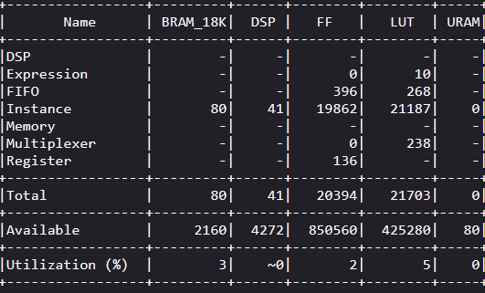
QR
QR
SVD
SVD
Arch1

Slide 14
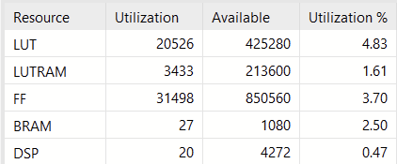
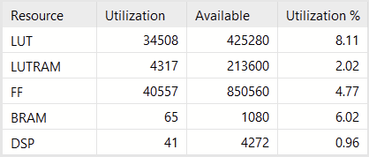


QR
SVD
Arch1

Slide 15
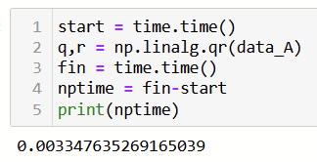
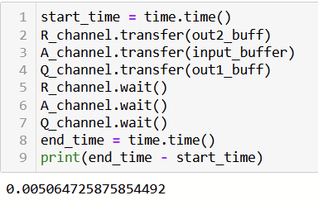
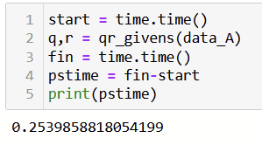

QR on the board - Arch1
PL
Numpy
Using Givens

Slide 16
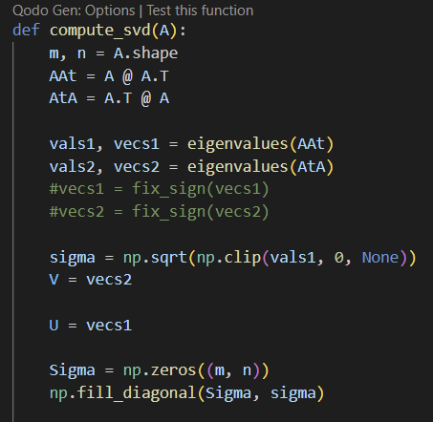
Implementing custom SVD
Apply Golub-Kahan method for bidiagonalization of the original matrix.
A = U @ J @ V.T
Apply SVD on J
U_final = U_golub @ u_svd
V_final = v_svd.T @ V_golub.T
Find pseudoinverse using sigma, U_final, V_final.

Slide 17
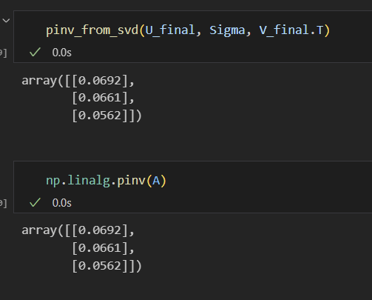
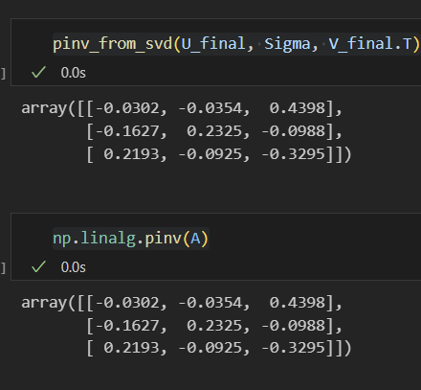
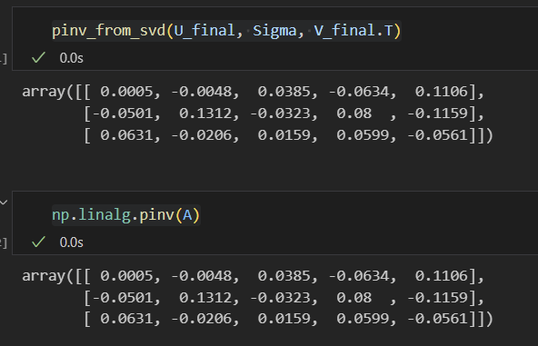
1x3
3x3
5x3

Slide 18
Thank you!!

